Slide 1

Telephone Customer Churn Analysis
Jamaal Smith
Flatiron School

Slide 2
Table of Contents
Executive Summary
Findings
Next Steps
Acknowledgement

Slide 3
Executive Summary
Identifying customers at-risk of changing services vital to business success. More funds expended attracting new customers than retaining old customers.
Development of classification model will assist with business retention efforts.
The goal of this analysis is to highlight the handful of customer characteristics that best portend future customer behaviors.

Slide 4
Table of Contents
Executive Summary
Findings
Next Steps
Acknowledgement

Slide 5
Initial Impressions of Data Set
Customers tend to stay with firm 85% of the time in dataset
What are the feature variables that are worth keeping for analysis versus those that are futile?
Are there any columns that we can dismiss at this moment?
Notes:
The dataset is comprised of 21 unique columns with 3333 rows of data. After first review, columns such as the phone number column can be deleted because a given phone number gives no insight into whether someone will leave their plan. By this, if someone had my phone number before, it isn’t logical to assume that my behaviors will be the same because I now have their phone number. This is why we can delete the phone column. Another feature variable that can be omitted is the state column. This is because there is no higher level of churn in one state that is attributable to the state alone that will allow us to make any useful insights.
As we can see, the churn phenomena is pretty scarce and most customers usually stay with the provider. Thus, identifying those feature variables that drive customers to eventually leave the company takes on even more significance

Slide 6
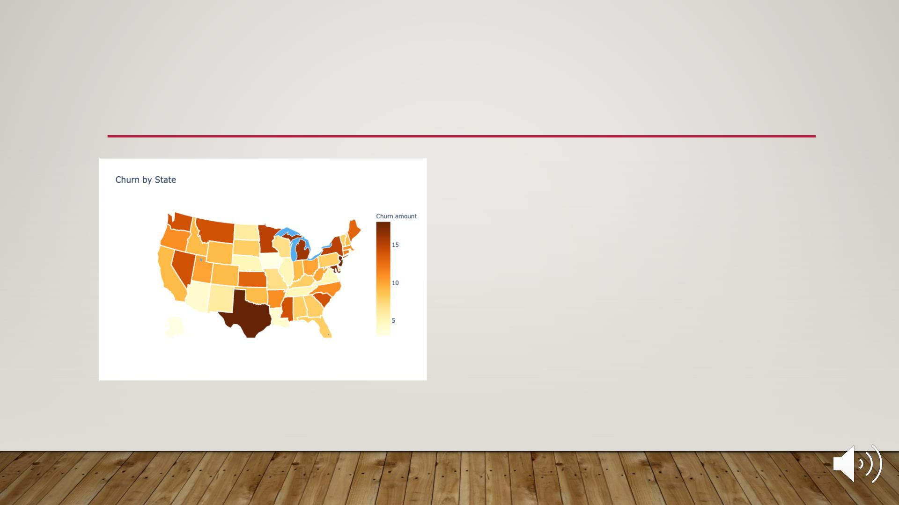
CHURN BY STAT E – IS CHURN A GEOGPRAPHICAL
PHENOMENA AS WELL?
• For states such as Texas, New Jersey
and Michigan; could churn be caused
by something specific to these
localities?
• Identifying exact cause of higher
churn in these specific states can be
valuable after-work opportunity.

Slide 7
MoSt Important features related to churn

Slide 8
Relationship between top 4 feature variables and Account Length/churn

Slide 9
XGBOost model performance – all variables versus feature selection
Accuracy = 94.5% (all variables)
Accuracy = 90.0% (top 4)

Slide 10
XGBOost model performance – all variables versus feature selection (CONT’D)
All Variables
Top 4

Slide 11
Table of Contents
Executive Summary
Findings
Next Steps
Acknowledgement

Slide 12
Recommendations
Promote packages that target a business consumer or personal consumers with international communication needs. In these packages, market to this type of consumer by championing the productivity gains that can realized through usage of voicemail plan features and savings for daytime usage and international calls..
The likelihood of a customer churning decreases dramatically when they are actively engaged with the voicemail feature.
Customers that use their phones more during the day than night churn less.
Customers that have an international plan and use it regularly are also less likely to churn
Monitor trends in why customers are calling into the customer service centers. As the number of interactions with customer service rise, so does the likelihood of churn

Slide 13

THANK YOU FOR YOUR TIME – FOLLOW-UP WORK
PROPOSALS
• It was a pleasure performing this analysis to assist with keeping your brand a leader in the
marketplace.
• As follow-up, we would be glad to:
• Perform analysis on the top 4 feature variables to provide the leadership team with a decision tree
that can establish important milestones that will enable your team to take proactive measures to
prevent churn.
• Feed new datapoints into the model so that your leadership team to ensure that the model is
adaptable to new datapoints and simply doesn’t replicate the training data.
• Examine the cause of higher churn in certain states. Is this a phenomena that is due to
infrastructure in that locality or other market forces that we might have been unaware of during
this analysis.

Slide 14
Table of Contents
Executive Summary
Findings
Next Steps
Acknowledgement

